Slide 1
Waukesha County Recycling
Waukesha County
Department of Parks & Land Use

Slide 2
Waukesha County Recycling Program
“Responsible Unit” for 25 Communities
Community “opt-in” resolutions
County administers state grant funds on behalf of 25 communities
County provides recycling dividends
$12 million since 2001
County leads/coordinates recycling education program
County funds recycling bins

Slide 3
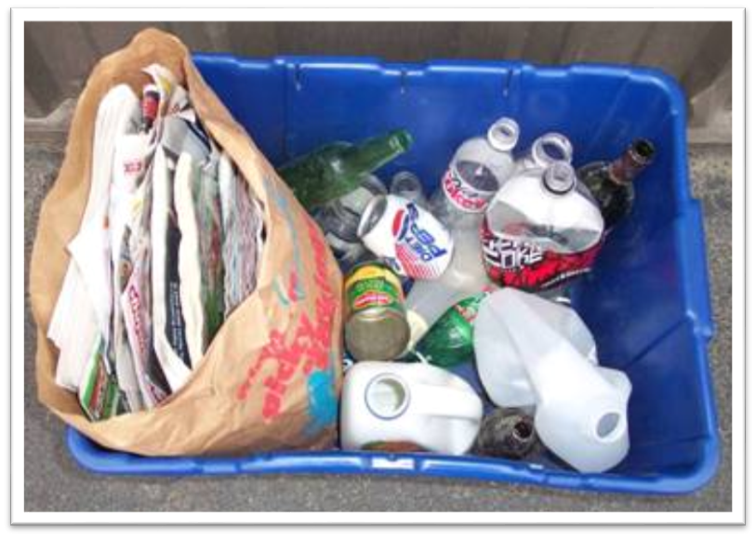
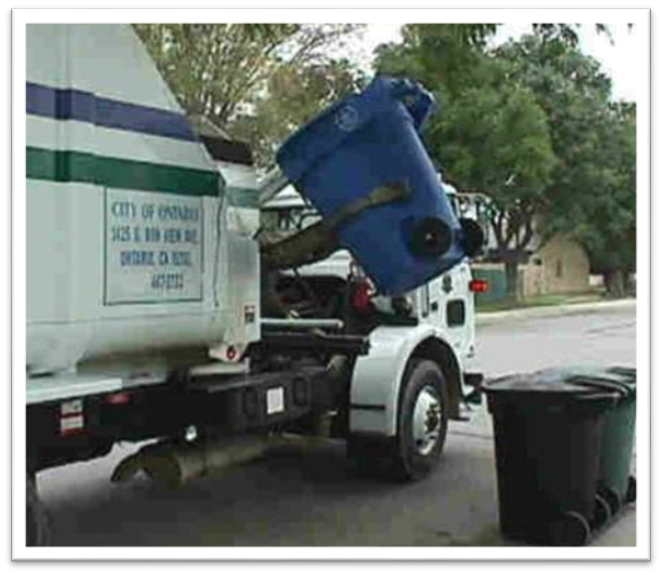
Recycling Program conversion
Dual Stream
Existing Program
manual/paper & containers separated
January 2015
Single Sort
Industry trend (cart)
automated/all recyclables mixed

Slide 4
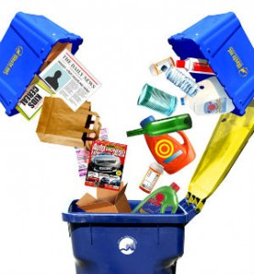
Advantages of Single Sort Recycling
Simplifies recycling
Larger, wheeled cart holds 5x more materials
More materials can be accepted
#1-7 plastics
More haulers offer the service
Competition for collection contracts

Slide 5
Advantages of Single Sort Recycling
Saves Money
Significantly increases recycling rates
Projected 38% increase for Town of Merton (AC)
Increased program revenue
Decreased landfill disposal costs & fees
6-12%
Automated Curbside Collection
Increased collection efficiency
Every-other-week recycling collection

Slide 6
Coordinated Collection Request for proposals
County facilitated on behalf of 20 municipalities
Highlights:
Competitive pricing from 4 companies & group pricing
No “bundling” of costs/transparency in prices & annual increases
Separation of refuse disposal costs allows community to realize cost savings from increased recycling and reduction in refuse
No “double dipping” on CPI and Fuel surcharges
No CPI on state tip fees & no “environmental fees”
Compare costs of services (Automated vs. Up-the-drive)

Slide 7
Local Collection Decisions
Municipal Contracts vs. Subscription Service
22/25 have municipal contracts
All 3 considering municipal contracts
Automated vs. Up-the-Drive Service (UTD)
Automated service proposal costs = 56% cost savings over UTD

Slide 8
Advantages of Municipal contracts
Lower cost for residents
Estimated greater than 50% cost savings based on proposals
Increased competition for contracts
Improved accountability and dispute resolution
Reduced noise, traffic and pollution
Improved efficiencies
Town will be eligible for County Financial Assistance

Slide 9
Municipal Service Considerations
Automated Curbside
Manual Up-the-Drive
96 Gallon Recycling Container
Increased recycling rate: >25%
Increased recycling revenue
Decreased landfill disposal costs: 12% est. diversion
Every-other-week recycling pick up = decreased collection costs
Increased collection efficiencies = decreased collection costs
32 Gallon Recycling Container
Recycling rate increase: < 25%
Lost recycling revenue
Higher landfill disposal costs: 6% est. diversion rate
Weekly collection = increased collection costs
Costs are estimated to be 56% higher than automated
Notes:
Annual cost savings $5-7/unit/month – $60-80/unit/year = over $200,000
Diversion is expected at 200 tons for automated curbside = average of 8,000/year in additional savings over the 7 year contract term (Total of $56,000).
Also, recycling tons through an automated curbside system are projected to yield an average of 178 more/year than in a UTD system which = over $17,000/yr (Total of over $100,000)

Slide 10
County financial assistance Recycling Containers and Direct Haul
To be paid annually in conjunction with dividend payment & will require:
Executed Intergovernmental Agreement (County & Municipality)
Executed municipal single sort recycling collection contract (Municipality/Hauler)
Estimated to provide the Town of Merton an additional $21,800/year
(based on an automated curbside collection service)
Notes:
13,370 for manual UTD service

Slide 11
Resident Questions
Seasonal Residents & Cost Savings
This is something that could be discussed during negotiations between the Town and Vendor
Town Transfer Station
Costs savings anticipated with automated curbside service under a municipal contract (based on one bag/week)
There are 17 municipal drop-off sites/transfer stations all with municipal collection contracts
The Town is not planning to close the site just remove the garbage dumpsters
Take materials to my business
Technically residential materials should remain separate from commercial
Loss of recyclables reduces revenue for municipality
Notes:
Costs for one bag/week = $168/year (not including fuel, time, labor, etc…)

Slide 12
Resident Questions
Up-the-drive service
Residents may have option to subscribe for this service at extra cost
Cost may be negotiated by Town for residents to obtain cost controls
Service is higher cost, not as efficient
Burning Solid Waste
Prohibited State-wide and in Town of Merton
Cost Savings
All costs provided to the Town are the actual proposals received from vendors
RFP and contract cost control provisions
80% pay for subscription service at $400 or more/year
Cost savings will be greater than 50%
Notes:
COSTS – discuss the adjustments briefly – assure there are limitations to fee increases.

Slide 13
Resident Comments Pro
Second time considered and interested in saving funds
Welcomes reduced costs
Endorses trying to control escalating costs
Strongly urges participation
Appreciates the savings offered
Championing the idea
Thrilled to have contract and cost savings
Time for contract – dump is inconvenient
Makes sense to not have multiple carriers

Slide 14
Residents comments Con
Saving money using the dump
Prefer dump
Too many taxes
Would rather choose contractor

Slide 15
Questions
Rebecca Mattano, Solid Waste Supervisor
rmattano@waukeshacounty.gov
Waukesha County Department of Parks & Land Use
262-896-8300

